Slide 1


IBVS for Drone operations
Course Code : AR514
Title: Vision and Learning Based Control
Group number: 06
Presenter Names : Jagadeesh Satwik Jaiswal
Name of TAs: Yogesh namdeo Dasgaonkar , Ankit Mehera
Name of the Course Instructor : Dr. Radhe Shyam Sharma
Date : 19/05/2024

Slide 2
Introduction
Title: IBVS System Design for Drone Operations
Aim: To design an IBVS system for drones that can perform operations such as search, hover, landing, and tracking.
Introduction: This project introduces an IBVS system for autonomous drone operations, enabling drones to search, hover, and follow moving vehicles using camera feedback. The system's effectiveness is demonstrated through simulations.

Slide 3
Problem Statement
Objective: The primary objective of this project is to design an Image-Based Visual Servoing (IBVS) system for drones, enabling them to autonomously perform crucial operations such as search, hover, landing, and tracking. The system leverages visual feedback from onboard cameras to navigate and interact with the environment, aiming to improve drone performance in dynamic settings.
Assumptions:
Color code: Every Ground vehicle in the environment is assumed to have an unique color code attached to it, facilitating easy identification and tracking.
Known Color ID: The drone is pre-programmed with the target Color ID before initiating the search operation, ensuring accurate identification of the target.
Obstacle-Free Environment: The system assumes an environment free of obstacles, except for the drone and the target object, to simplify navigation and interaction.

Slide 4
Literature Review
Solution name | Method used | Key features | Limitations | Reference
IBVS for Drone Operations | Uses visual feedback for control of Drone operations | Able to control drone operations based on the visual feedback | Challenges in low light conditions | Refrence1
PBVS for Drone Operations | Utilizes target object's position and orientation for drone operations. | Able to control drone operations based on the positional feedback | Challenges in unknown Environment | Refrence2
HBVS for Drone Operations | Combines Visual and Position based control for Drone operations | Able to control drone operations based on both visual and positional feedback | Challenge in switching between IBVS and PBVS | Refrence3

Slide 5
The Proposed Approach
Proposed IBVS Solution for Drone Operations
Our solution enhances drone autonomy and operational capabilities through Image-Based Visual Servoing (IBVS). Key features include:
Visual Feedback Processing: Detects and tracks ground vehicles for accurate navigation and interaction.
Sophisticated Control Algorithm: Uses onboard camera data to generate control commands, enabling precise drone movements.
Simulation Experiments: Validate the system’s performance in various conditions.
Benefits:
Less time complexity
Required Computation power is less
Fast in real time situations

Slide 6
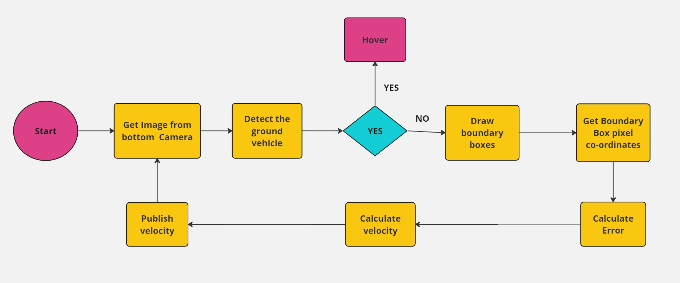
Methodology

Slide 7
Algorithm
Step1: Initialize kp (proportional gain)
Step2: Capture image from the downward-facing camera
Step3: Convert image to HSV color space
Step4: Create masks for blue, red, and green segments
Step5: Find contours for each color segment
Step6: Calculate centers of vehicle body (blue) and wheels (red, green)

Slide 8
Algorithm
Step7: Calculate angular error: θ = arctan((ry - ly) / (rx - lx))
Step8: Calculate linear error: ex = vx - fx, ey = vy - fy
Step9: Compute velocities:
V_linear_x = kp * ex
V_linear_y = kp * ey
V_angular = -kp * θ
Step10: Publish velocity commands to drone control system

Slide 9
Implementation Details
Software Requirements:
Simulation Environment:
Ros2​
Gazebo​
Python
Ground vehicle and Parrot Drone​
Downward-facing camera for image capture​
Control via Teleop Twist Keyboard

Slide 10
Implementation Details
Simulation Setup:
The simulation environment consists of a ground vehicle and a Parrot Drone.
The drone is equipped with a downward-facing camera, capturing images published on topic '/drone/bottom/img_raw'.
Image processing is done by '/image/subscriber' to generate velocity commands published on topic '/drone/cmd/vel'.
The ground vehicle can be controlled using Teleop Twist Keyboard.
When the ground vehicle starts moving, the drone initiates following it autonomously.

Slide 11
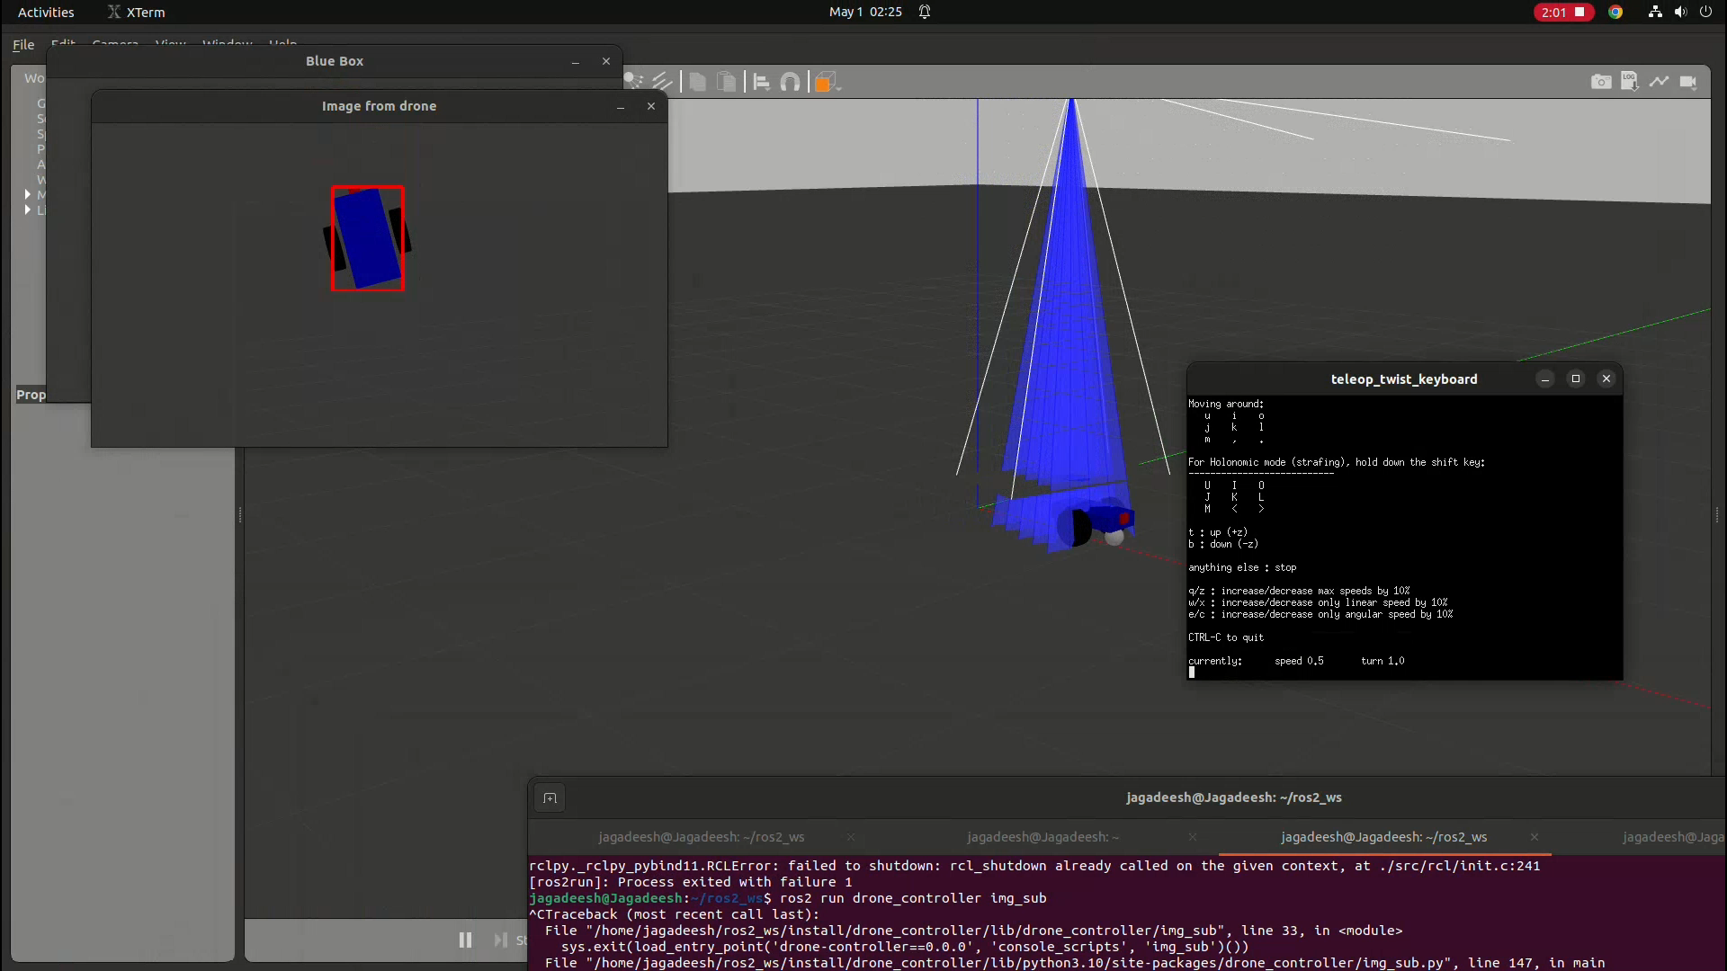
Demonstration
Demonstration of linear target tracking

Slide 12
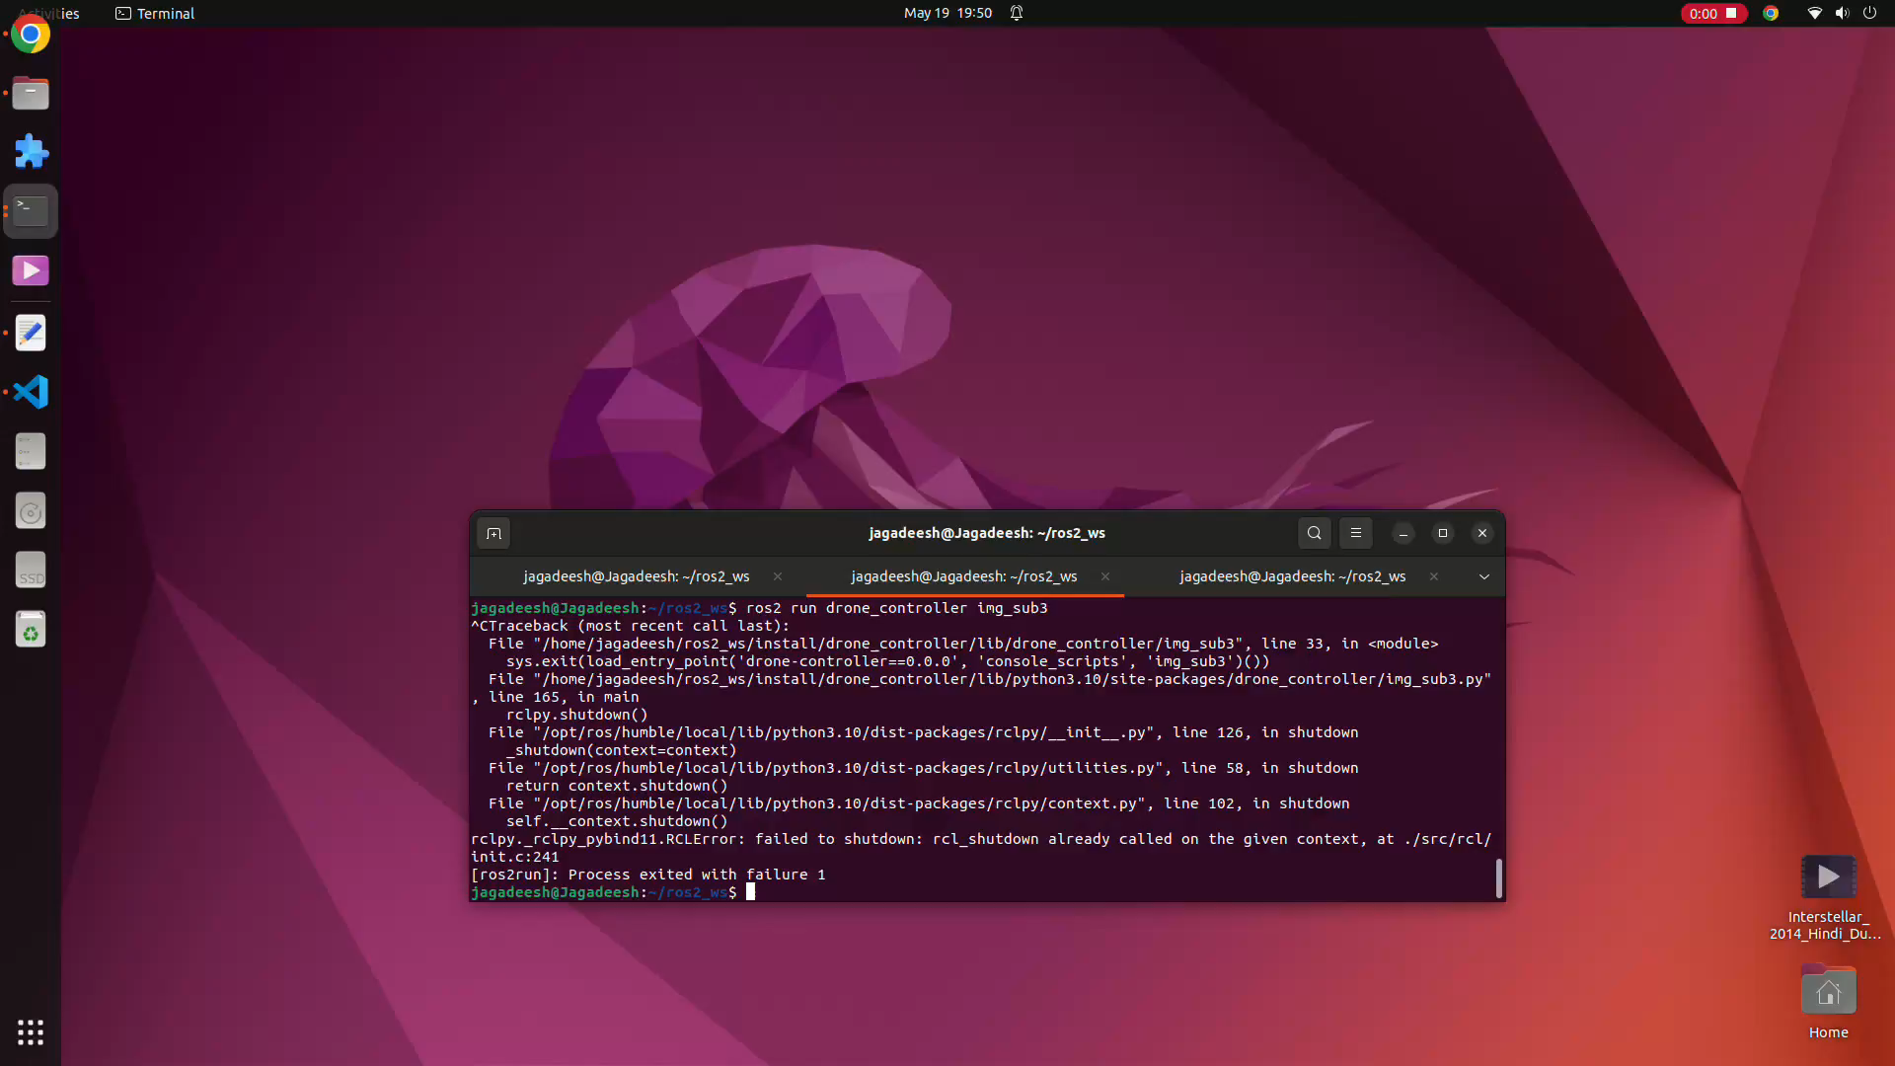
Demonstration
Demonstration of Angular target tracking

Slide 13
Results and Analysis
Simulation Results:
Successful search and hover over target marker.
Precise tracking of the moving ground vehicle.
Performance Analysis:
Accuracy: High precision in positioning and tracking the target marker.
Efficiency: Minimal computational overhead and rapid response to environmental changes.
Robustness: Performance in diverse environments, including scenarios with image noise and dynamic obstacles.
Key Findings:
Search and Hover: High accuracy and stability.
Tracking: Precision during movement.
Insights: Demonstrates efficient operation and robust performance.

Slide 14
Conclusion
Summary:
Robust performance of IBVS in essential drone operations.
High accuracy and stability in dynamic environments.
Enhanced autonomy and operational capabilities for various applications.
Conclusion:
The algorithm integrates computer vision techniques with control theory to enable a drone to autonomously follow a ground vehicle. By detecting and processing color-segmented regions, calculating positional and angular errors, and applying PID control, the drone can maintain a consistent position relative to the moving vehicle. This method demonstrates a practical application of image feedback for autonomous navigation in robotics.

Slide 15
Future Improvement
Potential Improvements:
Addressing limitations like image noise and low light conditions.
Testing in more complex and obstacle-filled environments.
Integration with other sensor modalities for improved performance.

Slide 16
References
https://github.com/NovoG93/sjtu_drone

Slide 17
Thank you

